Slide 1
SAT – Skill Analysis Tool
By
1. Harine Kanagaraj
2. Vishnu Kumar
3. Srist Sravan
4. JC Awe

Slide 2
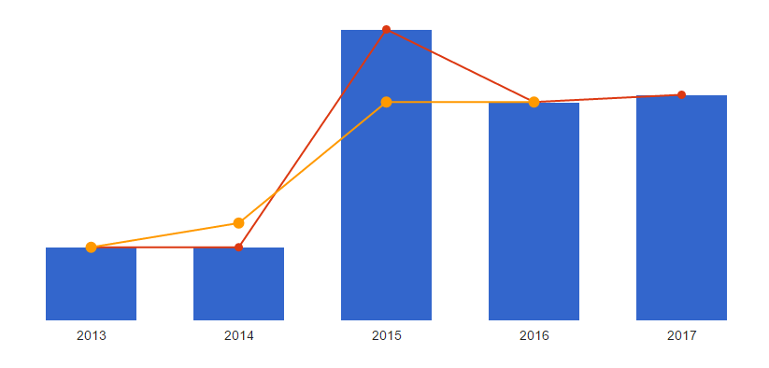
Problem Statement
Impact
Students lack required skillsets, due to rapid advancement in technologies.
Students may not be aware of skills required for their career progression.
Curricular activities and skill enhancement programs are not directed to the students in need.
Job trend VS QS ranking VS year
Students may not be proficient enough to get a job
It will be too late to acquire skill sets for students

Slide 3




Solution
The student will know the skillset required in the real world job market
SAT guides the students to appropriate portfolios where they can learn the skills required

Slide 4
Implementation
SAT tool :
Job description from NUS talent connect,
Job requirements.
Job market with Y skills
Find and Suggest to learn Y skills
Student with X skills
Resume, Linked In
NUS class on y skill , NUS workshops on y skill, meetup of people with y skills

Slide 5
Value preposition
Competitive advantage
Problem statement 1
Create awareness for students among different curricular activities and facilities provided by NUS
Useful for universities to know the most demanding skills
WIN – WIN situation for University and student
Analyse skill requirements
Direct them to the resource
Improve student proficiency in job market
Problem statement 2
Problem statement 3

Slide 6
Useful links
https://www.youtube.com/watch?v=g-iNp0xcY44&rel=0&utm_source=transactional&utm_medium=email&utm_campaign=Transactional-Publish-success
http://www.stjobs.sg/partners/nuscareerfair2017/
http://www.stjobs.sg/partners/nuscareerfair2016/
https://www.topuniversities.com/university-rankings/world-university-rankings/2016

